Slide 1
Student Accommodation Proposal
False Bay College - BayView, Mitchells Plain

Slide 2
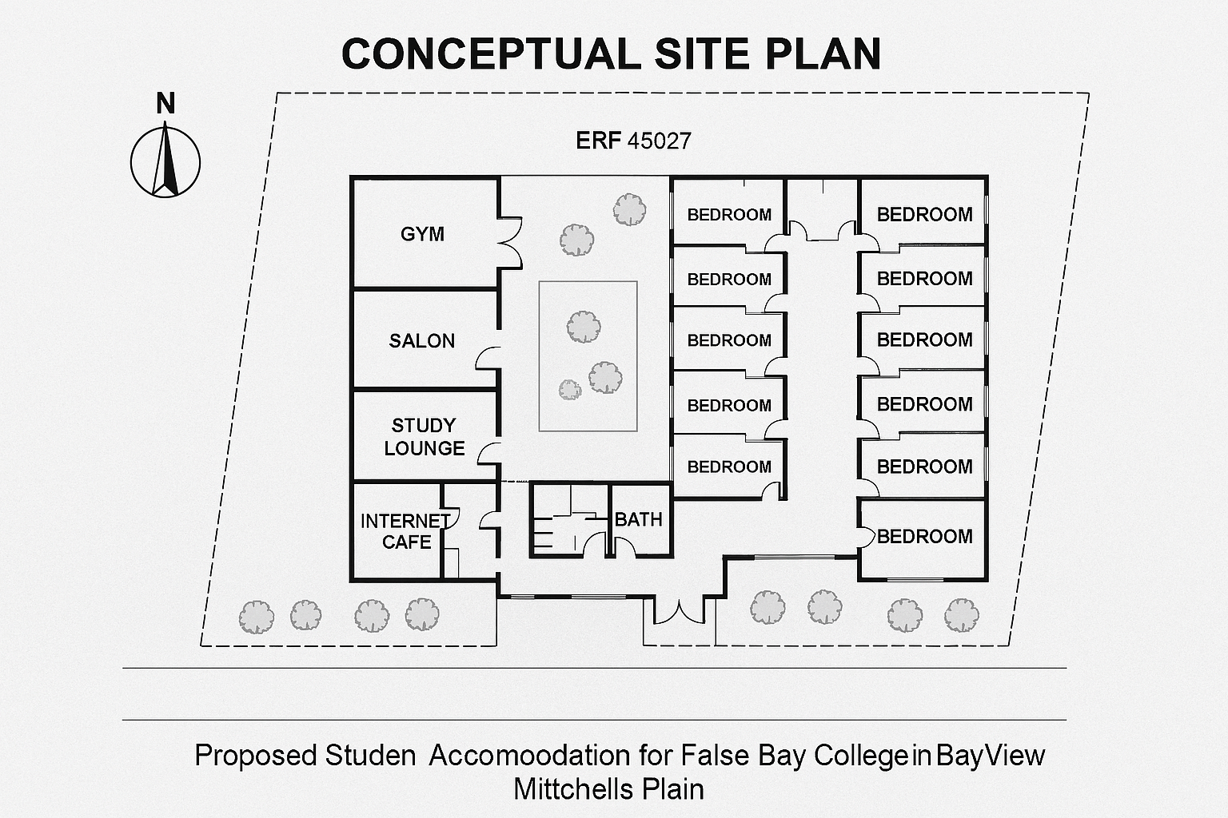
Conceptual Design

Slide 3
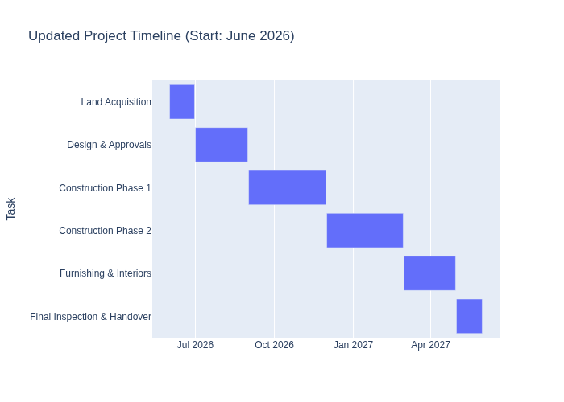
Updated Project Timeline

